Slide 1




Polybags
Biodegradable
Biodegradable plastics can be decomposed by living organisms — usually microbes — into water, carbon dioxide and biomass. These plastics are commonly produced with renewable raw materials, microorganisms, petrochemicals or a combination of all three.
Recycled and Recyclable
Plastics can be recycled through mechanical or chemical recycling. Mechanical recycling involves plastic being washed, ground and melted. Chemical recycling breaks plastic down into monomers to form new polymers that can be reused.
Compostable
Compostable plastics are derived from renewable materials such as corn, potato and tapioca starches, as well as cellulose, soy, protein and lactic acid. Compostable plastics and non-toxic and decompose into carbon dioxide, water and biomass.
Water soluble
Based on PVOH, Hydropol™ is an innovative, hydrophilic material that retains the necessary features of the LDPE polybag but allows for a full end-of-life options due to its water liking feature. Hydropol degrades into carbon dioxide, water and harmless biomass and can be dissolved in hot water for immediate disposal.

Slide 2








Polybag symbols and resin codes
Mobius Loop
Product is capable of being recycled but not necessarily accepted in all recycling collection systems.
Triman logo
Product can be recycled through household waste disposal sorting
Standard EN 13432/14955
Products certified to be industrially compostable according to the European standard EN 13432/14955.
PET - Polyethylene Terephthalate
HDPE - High-Density Polyethylene
PVC - Polyvinyl Chloride
LDPE - Low-Density Polyethylene
PP – Polypropylene
PS – Polystyrene
Miscellaneous - Polycarbonate, BPA and other plastics
CPE - Chlorinated polyethylene
AEVA - Ethylene Vinyl Acetate
Italian recycling symbols
Alpha numeric coding as per the EU directive.

Slide 3
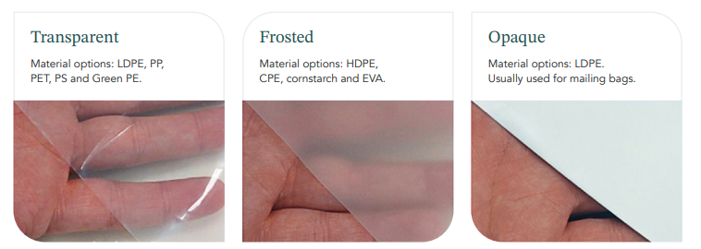

Finish options & closures

Slide 4
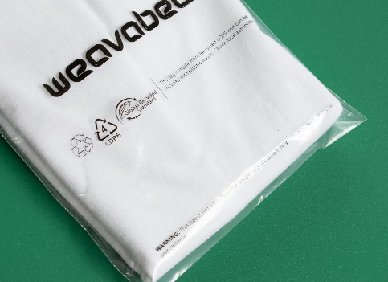
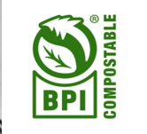
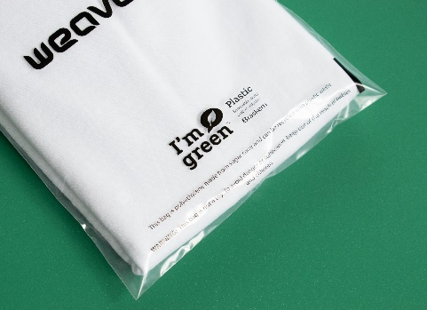
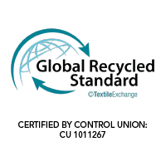
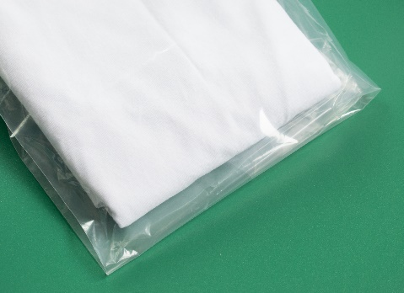
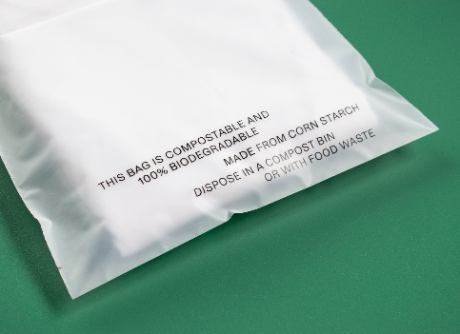

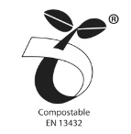

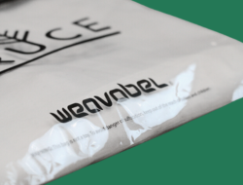
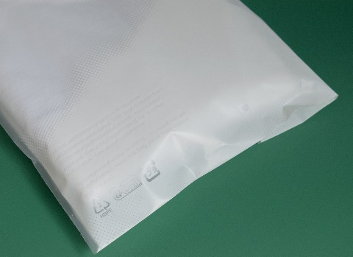
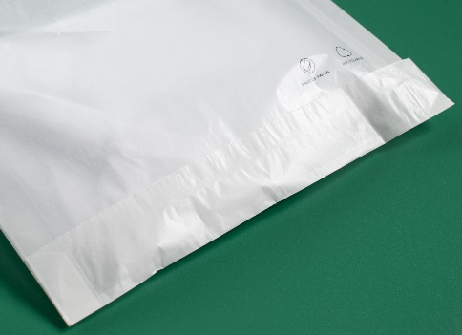
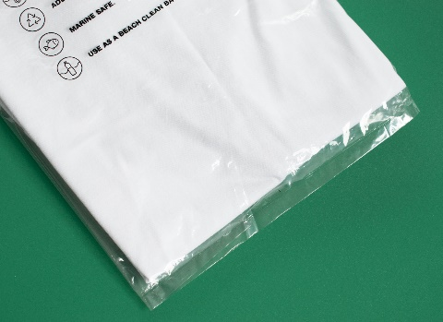
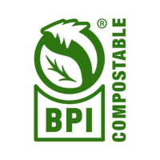
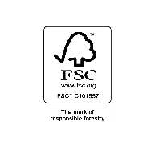
Qualities
Recycled LDPE
Recyclable
Recycled LDPE + D2W
Recyclable & Biodegradable
Cornstarch
Compostable
Green PE
Recyclable
Recycled HDPE
Recyclable
Spruce Paper Bag
Recyclable & Biodegradable
Water Soluble
Dissolution in hot water, biodegradable, compostable
Spruce Cellulose Bag
Sourced from sustainable wood pulp & compostable

Slide 5
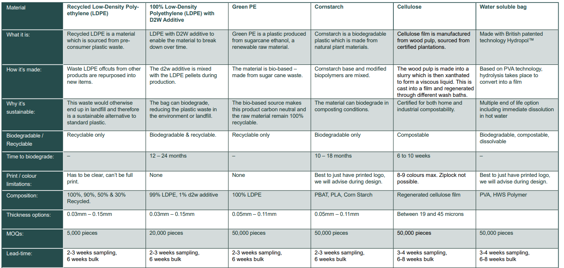
Sustainable polybag cheat sheet

